Slide 1

CREDIT CARD WEEKLY ANALYSIS
By Farheen Shaikh

Slide 2
Agenda
Project Overview
Import Data into SQL (Structured Query Language)
Connect SQL to Power BI
Data processing and DAX
Create a Dashboard
Insights from the report

Slide 3
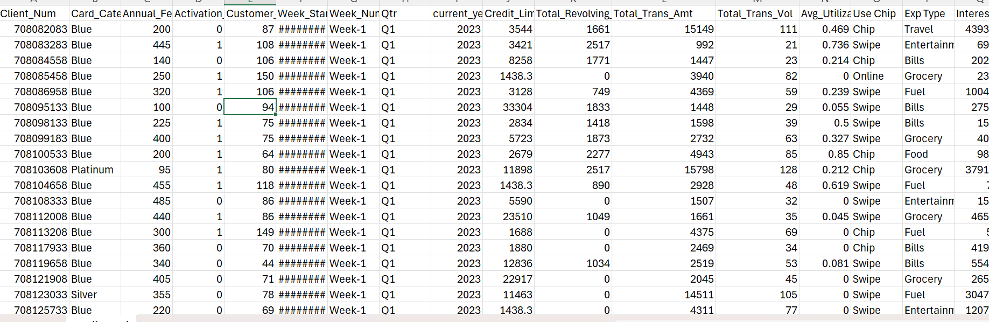
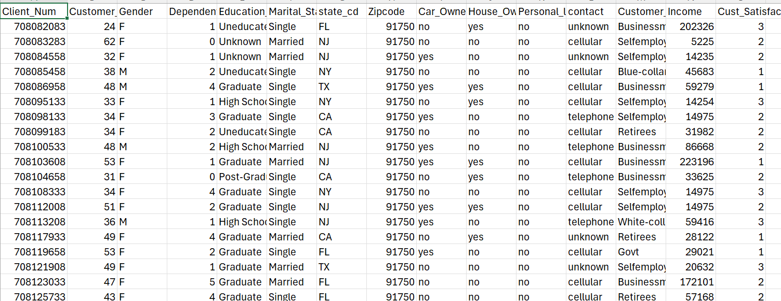
EXCEL SHEETS
Credit Card Transaction
Credit Card Customer

Slide 4
WHY THIS DATA?
Business perspective
Provides an opportunity to work on various aspects of the data
Not only uncovers patterns and behaviours but also provides a roadmap for strategic decisions
Provides good understanding of the revenue variations over each week/quarter which can help in business marketing
Large data set give you the opportunity to learn and explore more

Slide 5

Project Objective
To develop a comprehensive credit card weekly dashboard that provides real-time insights into key performance metrics and trends, enabling stakeholders to monitor and analyse credit card operations effectively.

Slide 6
PROBLEM STATEMENTS
Credit Card Transaction Report:
In which quarter the company has gained the highest interest amount?
Credit Card Customer Report:
Which gender category has contributed most to the company’s revenue in 2023?
Which specific week of the year has gained the highest revenue by Male category?
Which age group is generating the highest revenue?
What is the percentage of delinquent account in the last quarter of the year?
Which state has given us highest revenue in 2023?
How much is the total revenue of 2023?
Which card category has performed bad in the last week of the year?
Compare the transaction count between Q1 and Q4

Slide 7
Import data to SQL database
Download data from Kaggle
Prepare csv file
Create Database in SQL
Import csv file into SQL
Connect SQL Database to Power BI

Slide 8

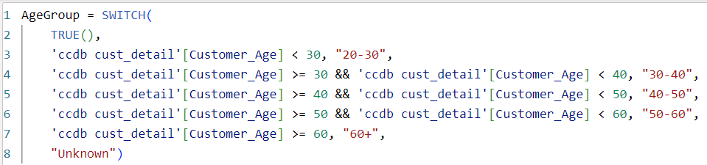

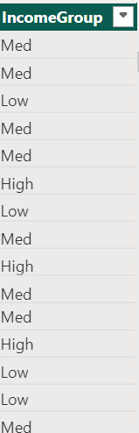
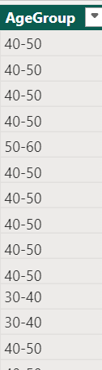
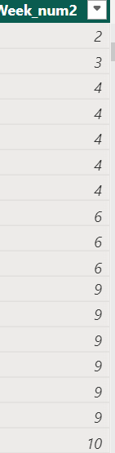
Data Cleaning and DAX Queries

Slide 9
Let me take you to the dashboard
https://app.powerbi.com/links/BBxYKn4Kox?ctid=6efd0f20-57c8-4447-b53f-00d4992ca50b&pbi_source=linkShare

Slide 10
Project Insights
Credit Card Transaction Report:
The Total Revenue of 2023 is 55M.
The company has gained the highest Interest amount in Q2 and Q3 which is 2M each.
The Platinum card category has performed worst in the last week of the year and only generated 0.01M of revenue.
The transaction count is more in Q1 as compared to Q4.
Q1=163k Q4=162k
Credit Card Customer Report:
Male customers have contributed more to the company’s revenue which is 30M and female is 25M.
Week May 21 has gained the highest revenue by Male Category around 722k.
The age group 40-50 is generating the highest revenue around 25M.
1.4% is the delinquent rate in the last quarter of the year.
Taxes is giving the highest revenue around 13M.

Slide 11
RECOMMENDATIONS
The revenue seems slightly less in the last quarter of the year so company can organise some cashback plans to attract the audience during the Christmas time.
Platinum card is the less selling card during 2023 so company can provide some extra benefits on its purchase to enhance the selling point.
Company can utilize diverse communication channels to engage with the expanded audience specially females to gain more customers.
Most of the customers are coming from 40-50 age group so company can organise campaigns to target expanded audience.
Company can introduce credit card features catering specifically to the health and wellness needs of the 50+ age group.

Slide 12

Hope you like it! Thank you for the opportunity!

